Slide 1

Biomarkers redux?
Laura J. Niedernhofer, M.D., Ph.D.
Optimist
Department of Biochemistry, Molecular Biology and Biophysics
Institute on Biology of Aging and Metabolism
lniedern@umn.edu

Slide 2
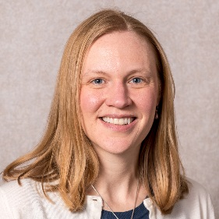
Utility of mice in biomarker discovery
 | Strength of mice | Complicates translation
Controlled genetics | √ | √
Controlled environment | √ | √
Endless supply of tissues | √ | √
Reporter mice | √

Slide 3
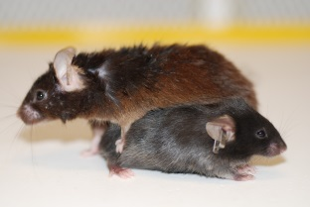
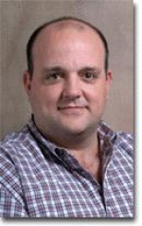
Heterogeneity of aged inbred mice
n=397
n=397
C57BL/6J
Male
n = ~400
Old: 23-24 months old
n = 67
n = 104
Rafa de Cabo
NIH/NIA

Slide 4

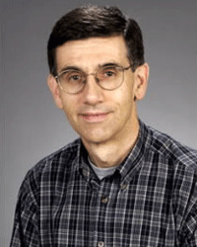
Potential surrogate endpoints
or biomarkers
Proxy measures
ATF4
Xenobiotic metabolism
Immunoproteosome activity
Proliferation capacity
GH – IGF-1 axis
Vascular density
Stress response
Serum peptides
Lifespan
Chronological age
Healthspan
Metabolism
Oxidative stress
Senescent cell burden
Frailty
Age-related disease
urinary Alb/Cre
anemia
senescence
Functional assessment
SIRT1
NF-kB activity
Circulating factors
glucose
triglycerides
cholesterol
IGF-1
testosterone
FSH
IGFBP1
adiponectin
leptin
Biological age
Protein carbonylation
Lipid hydroperoxides
Lipofuscin
Oxidative DNA damage
SA-βgal, p53, p16, TAFs, TIFs, γH2AX, SAHF, SASP
plasma uric acid, WBCs, ESR, triglycerides, homocysteine, glucose, HbA1c, creatinine, cystatin C, IGF-1, fibrinogen, von Willebrand Factors VIII and IX, oxidized proteins, 8-oxodG, protein carbonylation, C-reactive protein, IL-6, and IL-1RA and decreased plasma Hgb, total cholesterol, HDL, vitamin D, testosterone, adiponectin, vitamin C and E, selenium, magnesium, and carotenoids
disease-specific measures
Ageing Res Rev. 2016 Oct 6. pii: S1568-1637(16)30057-5.
Molecular pathology endpoints useful for aging studies.

Slide 5
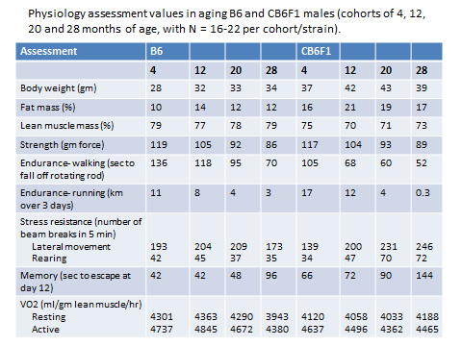

Cross-sectional studies in mice
Age (months)
Differences in rates of functional decline between genetic backgrounds

Slide 6
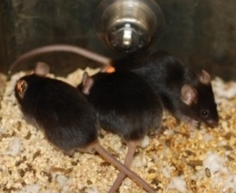
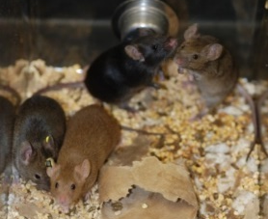
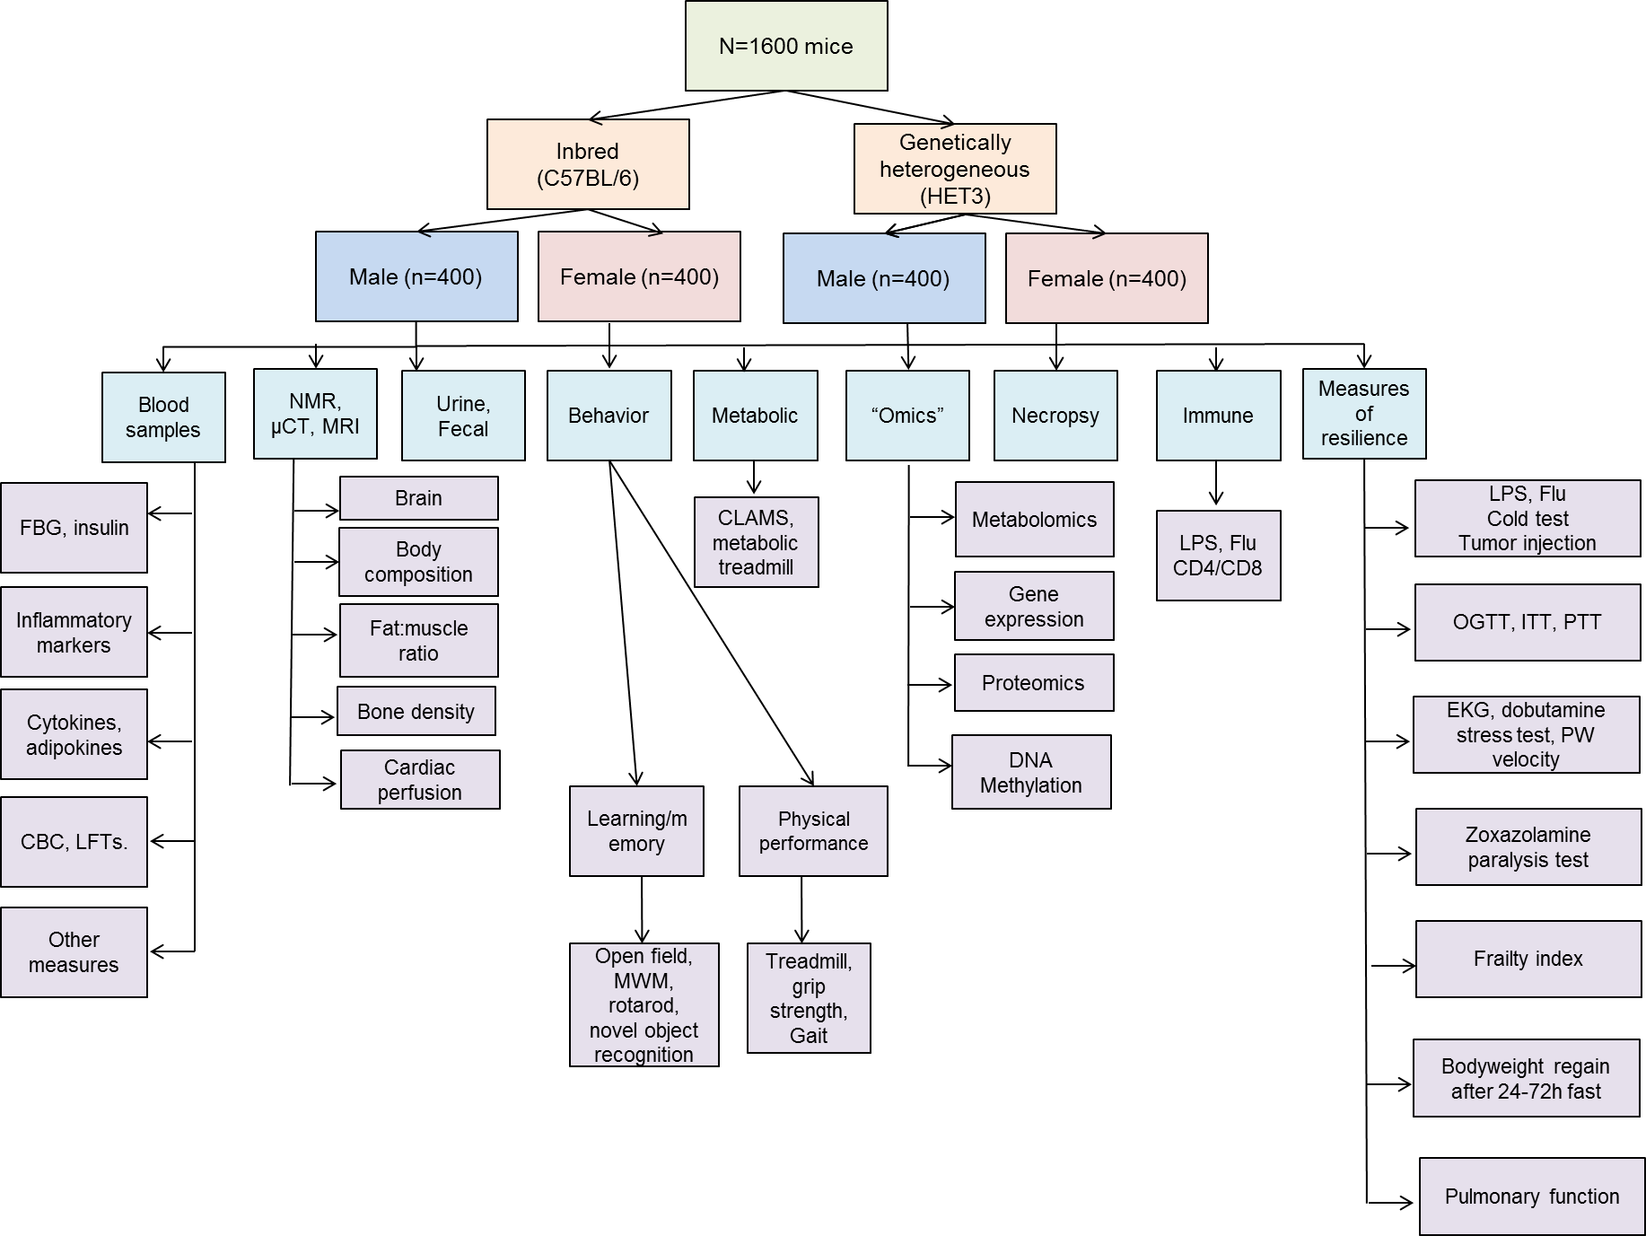
Longitudinal study in mice Multi-PI SLAM study at the NIA Baltimore

Slide 7
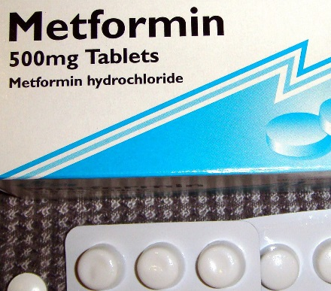
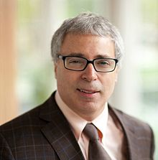
Geroscience Network
TAME TRIAL
Biomarkers is part of the study aims: to guide future studies for discovery of pathways to target and novel therapeutics.
Biomarkers is part of the innovation: secondary and tertiary endpoints measured can be linked to endpoints may yield a panel of biomarkers that expedited future trials.
Biomarkers is part of a core to support ancillary studies to discover new biomarkers.
NIH/NIA R24 AG044396
Geroscience Network
James Kirland
The Mayo Clinic

Slide 8
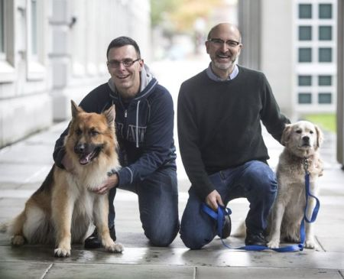
The Dog Aging Project
Longitudinal study of 10,000 dogs
Define healthy aging via clinical data, medical records, physical function, demography
Use systems biology to uncover mechanism
Genome
Epigenome
Microbiome
Metabolome
Opportunity to truly validate a biomarker of aging
test predictive value
responsiveness to intervention
shared environment
Discovery component
Unprecedented ability to measure large #s of endpoints in parallel
NIH/NIA R24 AG044284
Daniel Promislow
University of Washington

Slide 9
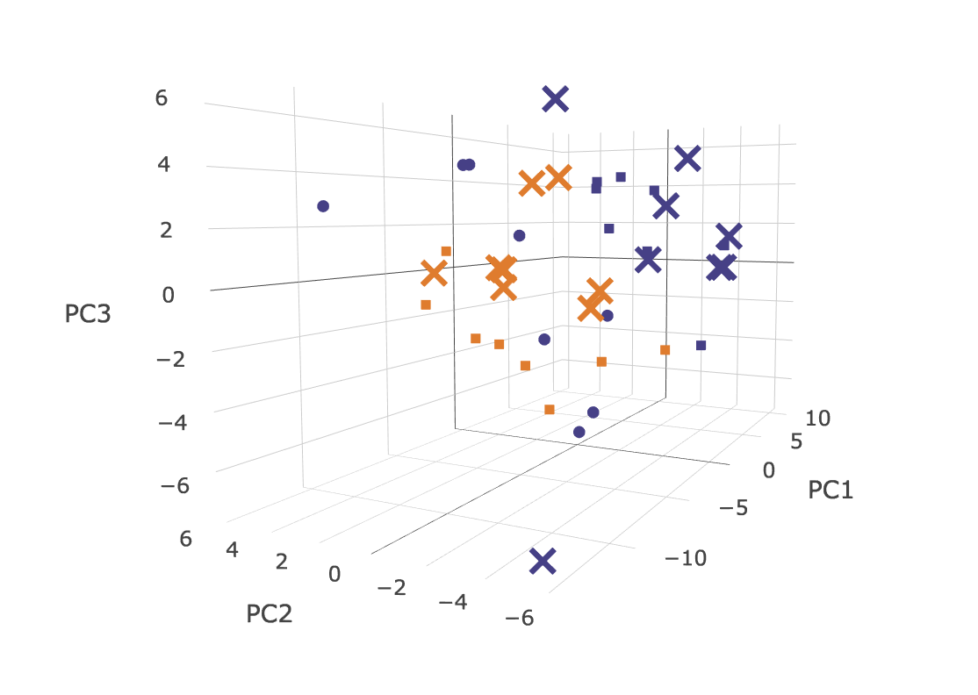
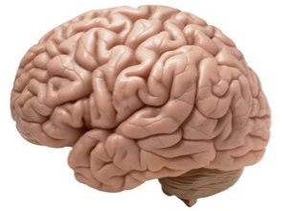
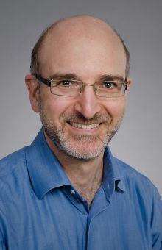

Metabolic profiling by University of Washington Nathan Shock Center
WT 8 wks
WT 16 wks
WT 2.5+ yrs
Ercc1^{-/Δ} 8 wks
Ercc1^{-/Δ} 16 wks
A marker of biologic age may be a profile rather than a molecule

Slide 10
Geropathology Network
To arrive at a refined set of sentinel biomarkers of molecular and anatomic pathology that could be incorporated into preclinical and clinical aging intervention studies to increase the relevance, productivity, efficiency and economy of these studies.
NIH/NIA R24 AG047115
Geropathology Network
Warren Ladiges
University of Washington
The Geropathology Research Network:. An interdisciplinary approach for integrating pathology into research on aging.
W. Ladiges, Y Ikeno, L Niedernhofer, R A McIndoe, M Ciol, J Ritchey, D Liggitt (2015) J Gerontol: Biol Sciences.

Slide 11
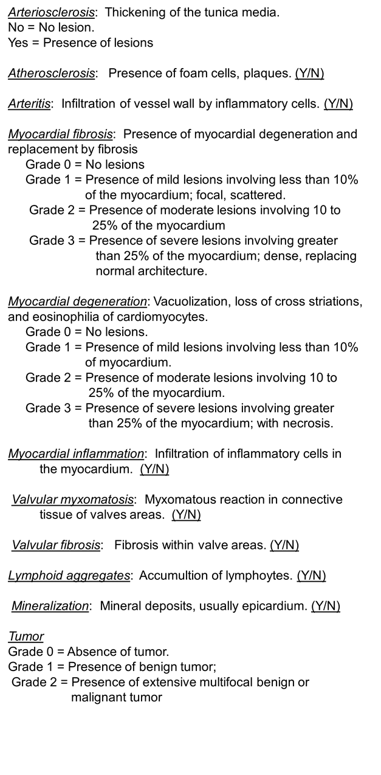
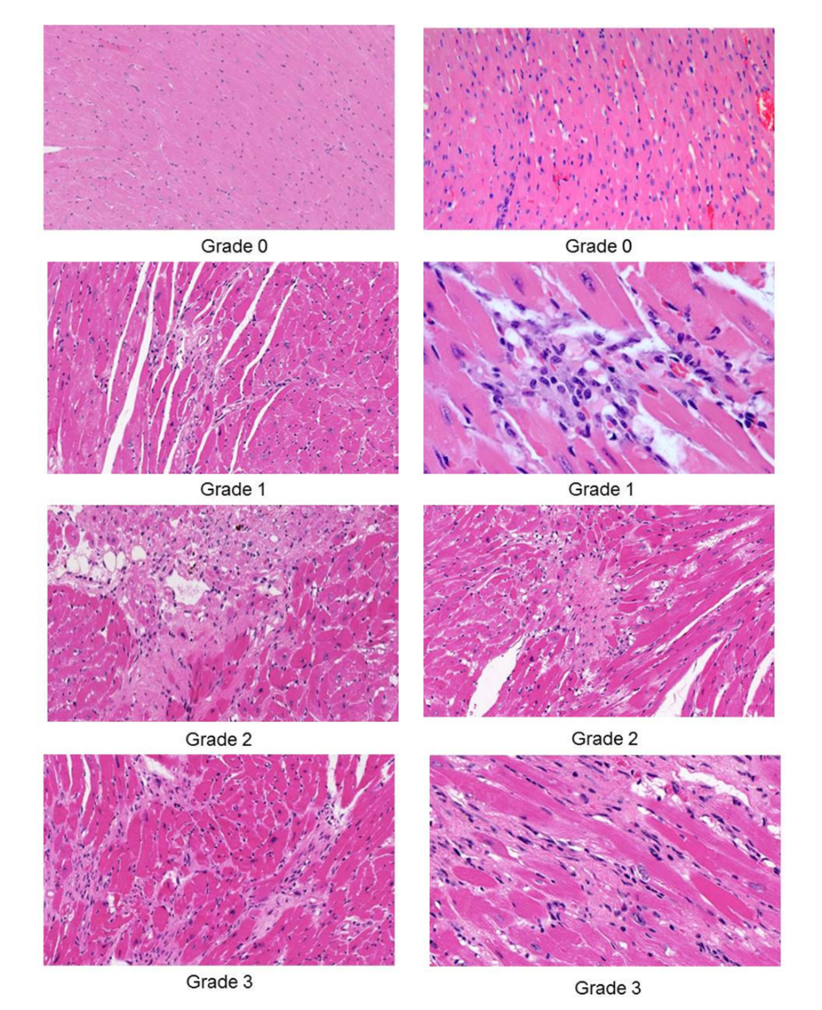
Guidelines for composite lesion score (CLS) of organ-specific aging pathology
Myocardial fibrosis

Slide 12
CLS: histopathologic measure of biological age
C57BL/6N
CB6F1N
Kidney
Liver
Heart
Lungs

Slide 13
Our approach to biomarker discovery in mice
Cross-sectional study using existing murine samples
Examine multiple age groups
>1 genetic background
Use genetic and pharmacologic interventions that alter the rate of aging to challenge the robustness of the putative biomarker(s).
Attempt translation

Slide 14
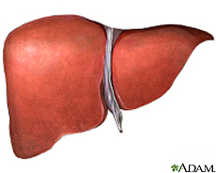
Differential MS Proteomics for biomarker discovery
Protein data
8m
Randomized
Feature alignment
& quantification
Block processing
Label-free
Blinded
Serial nano LC-MS/MS

Slide 15
Calculating biological age against a reference population using a proteomics profile

Slide 16

Cytokine Mouse 20-Plex Panel for Luminex™ Platform to screen for serum biomarkers
Cytokines | Chemokines | Growth Factors
GM-CSF | IP-10 | FGF-basic
IFN-γ | KC | VEGF
Il-1α | MCP-1
IL-1β | MIG
IL-2 | MIP-1α
IL-4
IL-5
IL-6
IL-10
IL-12 (p40/p70)
IL-13
IL-17
TNF-α
Mouse Age (mths)
Matt Yousefzadeh

Slide 17
Serum MCP-1 levels increase faster in progeroid mice
WT f1
Ercc1^{-/Δ}
BubR1^{H/H}
C57BL/6
Yousefzadeh et al. 2017 Aging Cell

Slide 18
Serum MCP-1 levels are reduced by genetic and pharmacologic interventions that extend health- or lifespan
WT f1
Senolytic treatment of progeroid mice
Treating aged WT mice with rapamycin
Ercc1^{-/Δ}
p65+/-;Ercc1^{-/Δ}

Slide 19
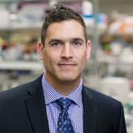


Translates: Plasma MCP-1 levels are elevated in frail elderly adults
Older adults undergoing valve replacement surgery for severe aortic stenosis.
Frailty defined as ≥3:
slow gait
weak grip
↓ physical activity
↓ endurance
unintentional weight loss
Nathan
LeBrasseur
Marissa
Schafer

Slide 20


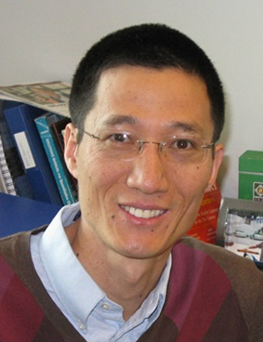
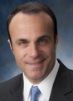

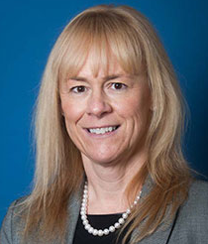


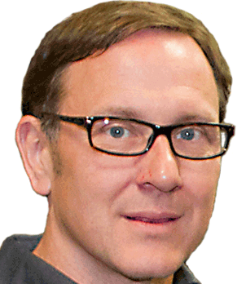
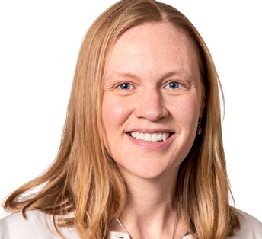
NIA P01 AG043376
Paul Robbins
TSRI
Signaling
Johnny Huard
UTHS
Stem Cells
Yinsheng Wang
UC Riverside
DNA damage
Eric Kelley
U Pitt
ROS Biology
Simon Watkins
U Pitt
Advanced imaging
Claudette St. Croix
U Pitt
LCI
Donna Stolz
U Pitt
EM
Nathan Yates
U Pitt
Proteomics
Gary Siuzdak
TSRI
Metabolomics
Christin Burd
OSU
Senescence

